Slide 1
Introduction to Lean 4
Wang Yutong@NUS

Slide 2
Why use lean
Lean is an interactive proof assistant
Verifiable statements and proofs => equivalent to logic reasoning
Modern and friendly interface
Largest and the most active community
Lean is based on dependent type theory
Type theory: avoid set theory paradox
Structure other than underlying sets

Slide 3
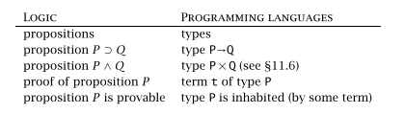
Why use lean
Curry-Howard Isomorphism

Slide 4
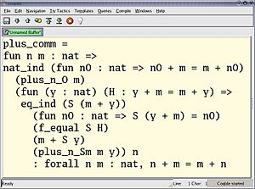
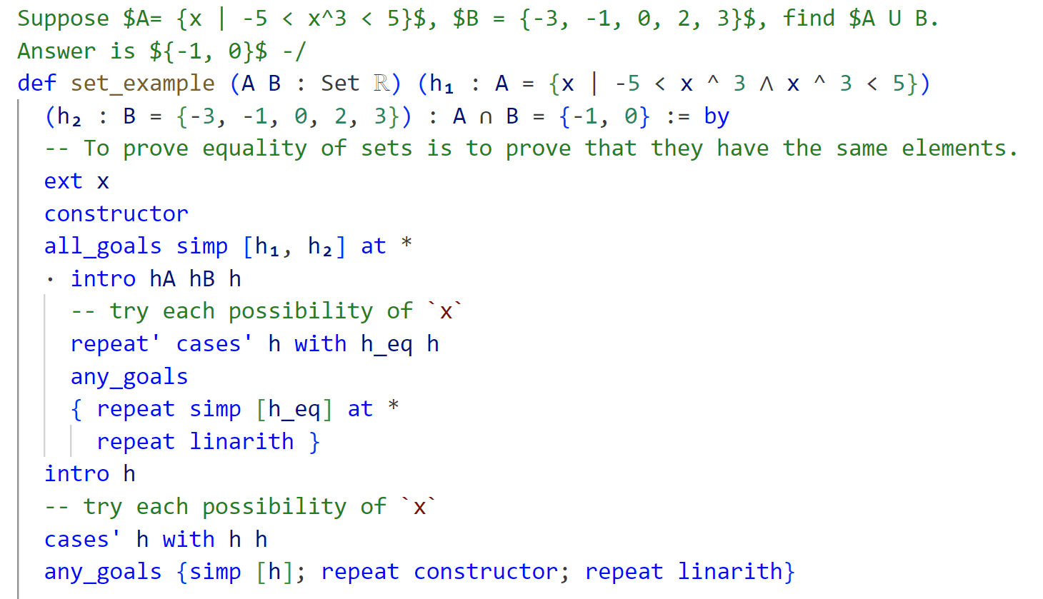
Why use lean
Coq: Earlier Proof Assistant

Slide 5
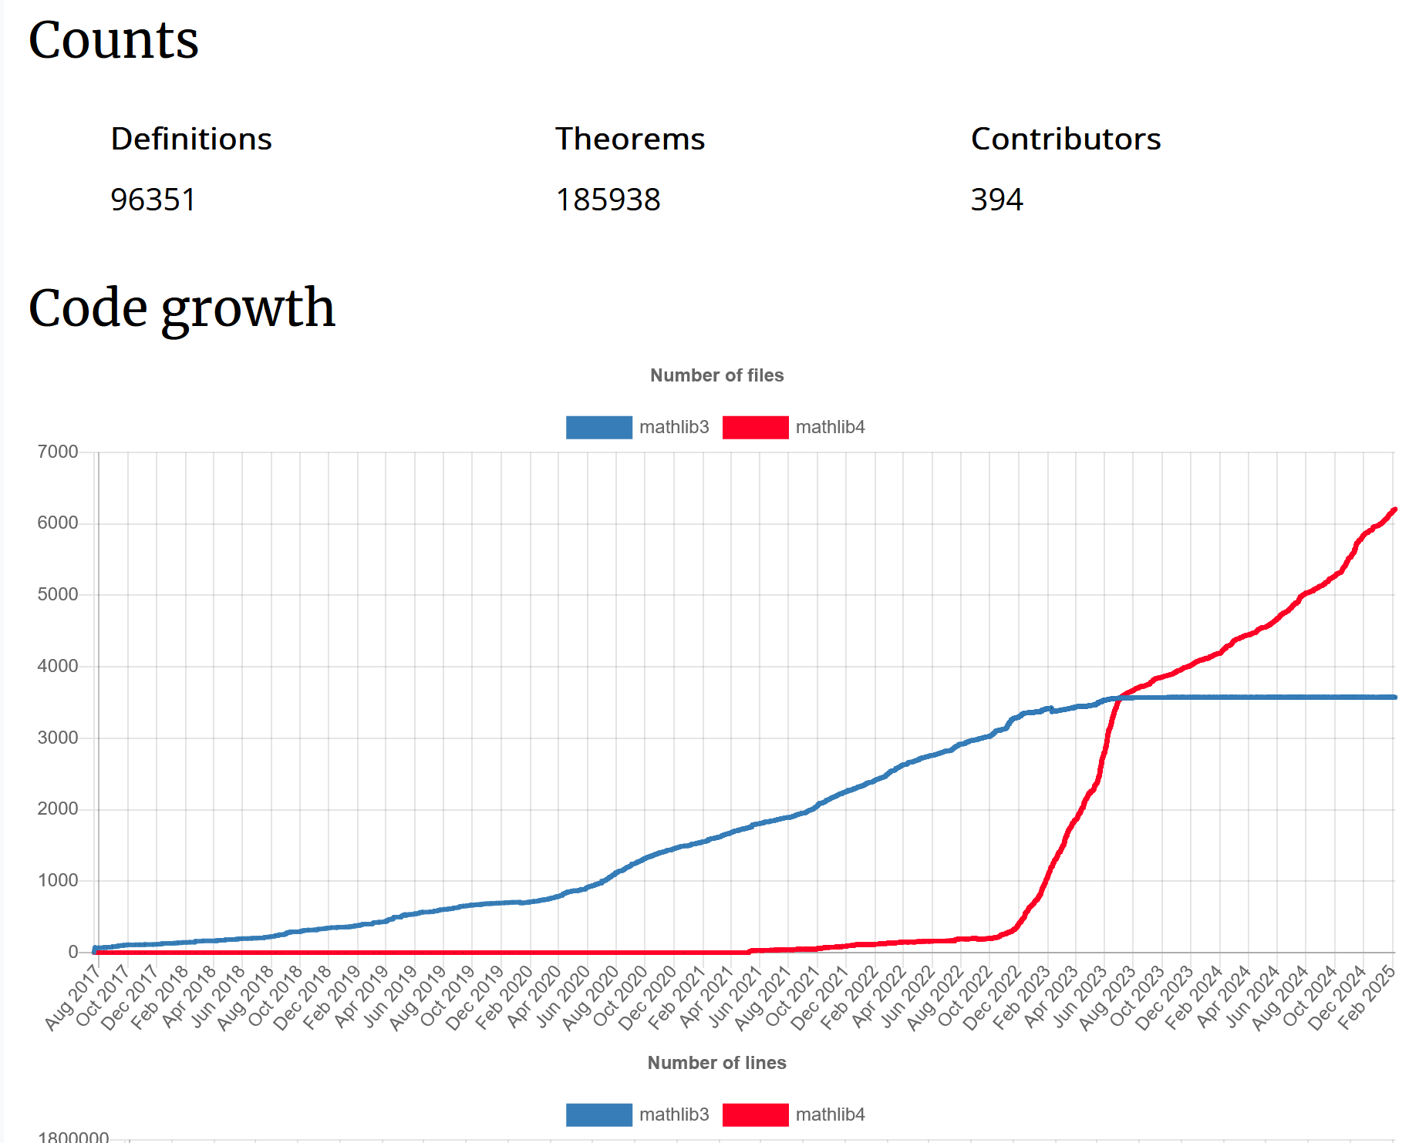
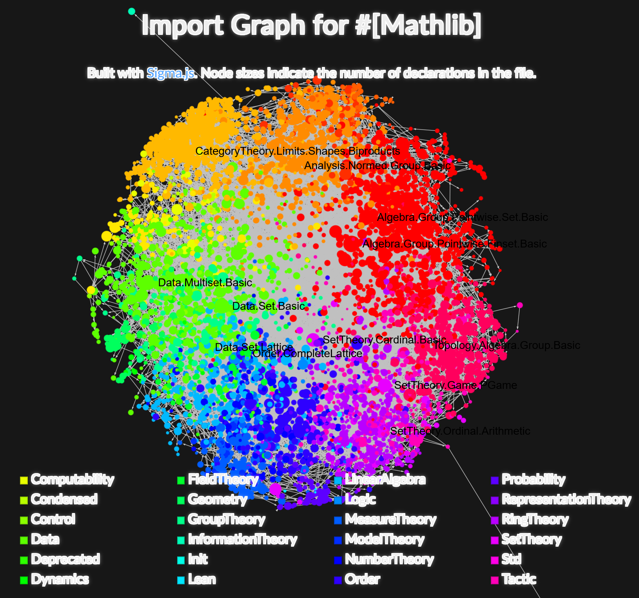
Why use lean

Slide 6
Basic syntax
Type & Value

Slide 7
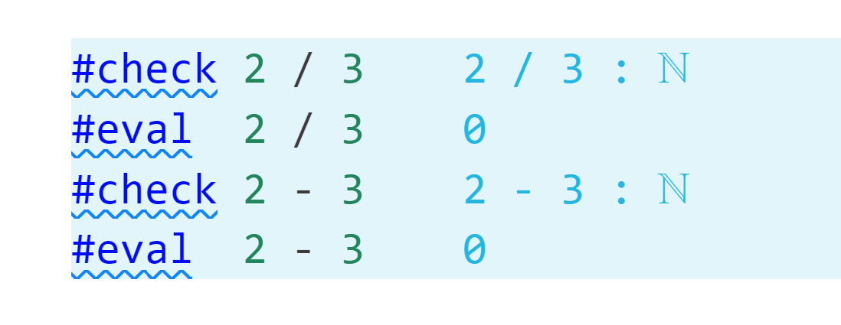
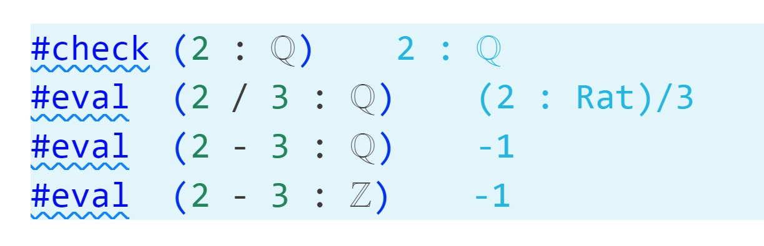
Type & Value
Each value is associated with a type
Type: ℕ ℤ ℚ ℝ : Type
Value of type: (2 + 2 : ℕ) (2 / 3 : ℚ) (2 - 3 : ℤ)
Each type has its own rules for computation

Slide 8
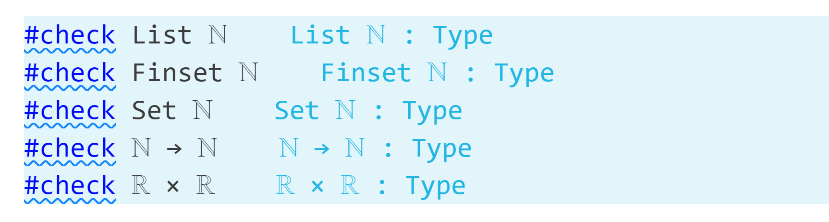
Type & Value
Type can be used to construct new types
Type: ℕ ℤ ℚ ℝ : Type
New type: ℕ → ℕ, ℝ × ℝ, Finset ℕ, List ℕ

Slide 9
Type & Value
Each value is associated with a type
Type: Prop
Value of type: (2 + 2 = 4 : Prop)
Values of type Prop is called propositions in math, when you provide value for a proposition, you are proving this proposition.
Most of time, we will call this kind of def as a theorem.

Slide 10
Demonstration

Slide 11
Proof Theorem
Simple proof

Slide 12
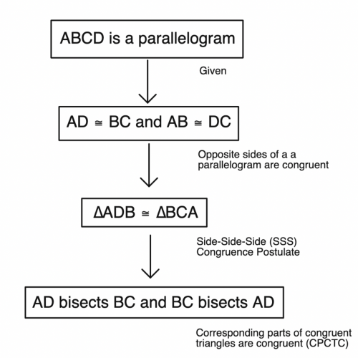
Prove theorem
Type 1
Theorem 1
Type 2
Theorem 2
Type 3
Theorem 3
Target

Slide 13
Prove theorem
A direct proof
(term-proof)
example (a b c : ℝ) : a * b * c = b * c * a :=
(mul_assoc a b c).trans (mul_comm a (b * c))
A step-by-step proof
(tactic-proof)
example (a b c : ℝ) : a * b * c = b * c * a := by
rewrite [mul_assoc]
rewrite [mul_comm]
exact rfl

Slide 14
Tactic proof
Over 300 different tactics in Mathlib
Simple: exact, rw, apply, rfl, calc …
Our target
Medium: simp, ring, group, refine, …
Advanced: linarith, norm_num, field_simp, …
Super: aesop, ?, …

Slide 15
mathlib4

Slide 16
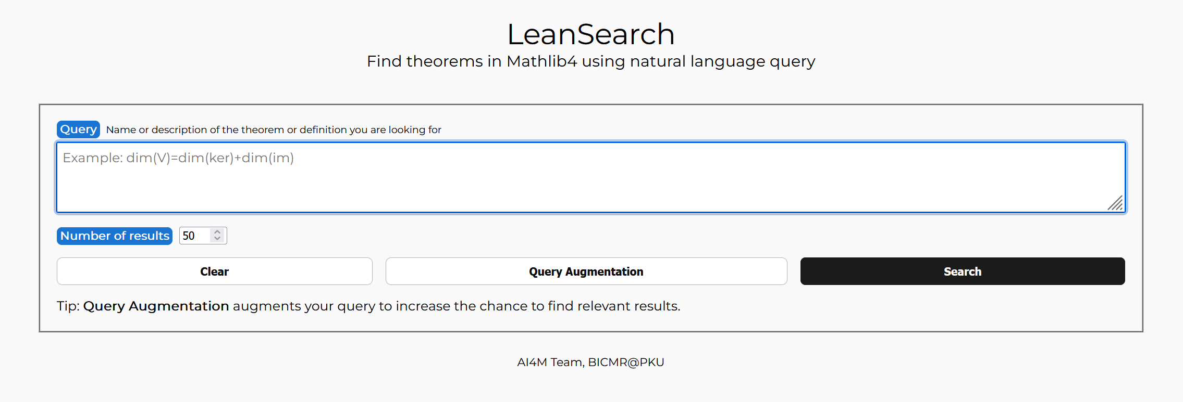
Leansearch
A semantic search engine for Mathlib theorems
16

Slide 17

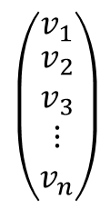
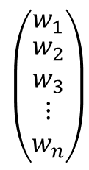
Leansearch
Theorem Database
Theorem 1
theorem statement 1
Stone-Weierstrass theorem
Search Query
Theorem 2
theorem statement 2
Stone-Weierstrass Approximation Theorem
A fundamental result in real analysis stating that any continuous function defined on a compact interval can be uniformly approximated as closely as desired by a polynomial function.
Augmented Query
Existence of Uniform Approximation for Continuous Functions
For any continuous function ff on the closed interval [a,b] with real values, and for any positive real number ε, there exists …
$$\left(\begin{matrix}w_{1} \\ \begin{aligned}w_{2} \\ w_{3} \\ ⋮ \\ w_{n}\end{aligned}\end{matrix}\right)$$
$$\left(\begin{matrix}v_{1} \\ \begin{aligned}v_{2} \\ v_{3} \\ ⋮ \\ v_{n}\end{aligned}\end{matrix}\right)$$
Similarity Computation
Theorem M
theorem statement
https://arxiv.org/abs/2403.13310v1
17

Slide 18
some recent Tools
Search, translate and prove

Slide 19
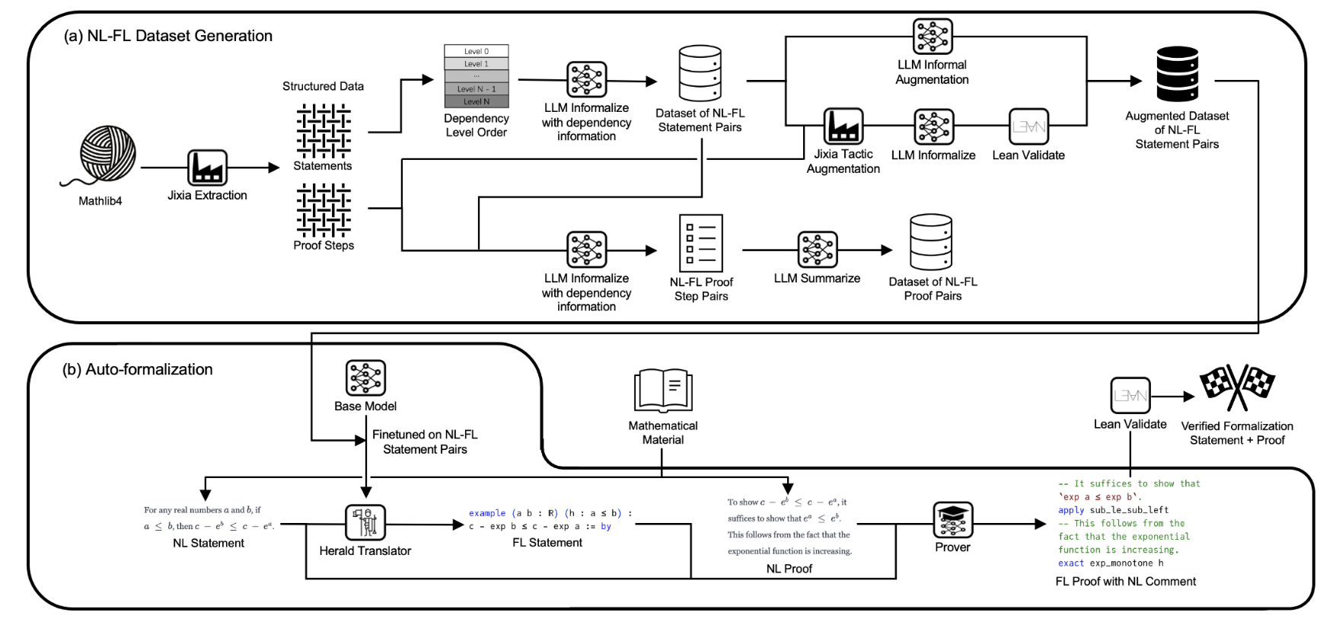
Lean translator

Slide 20
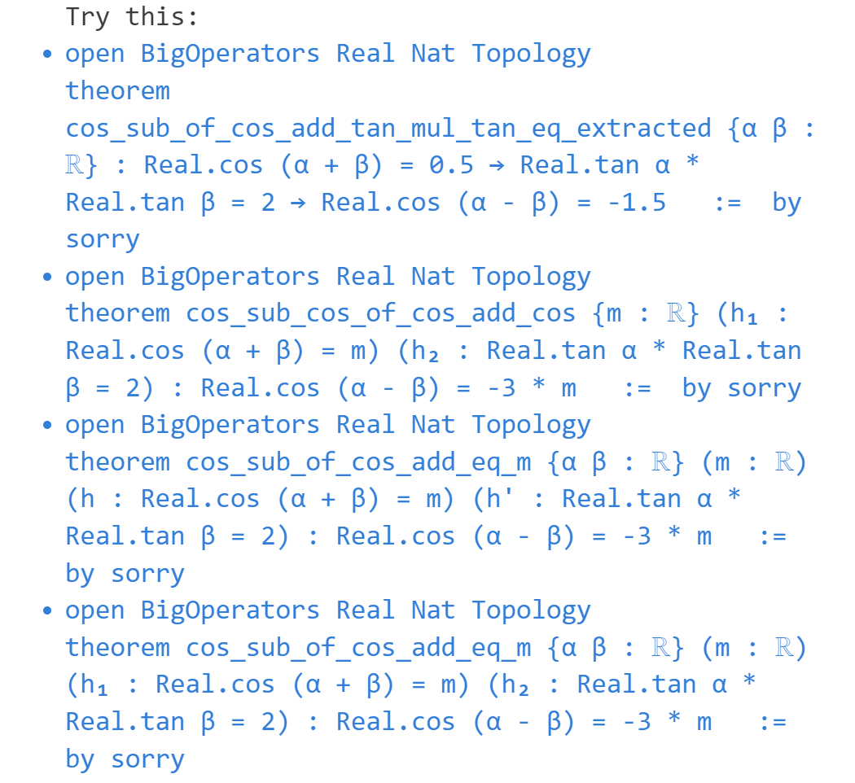
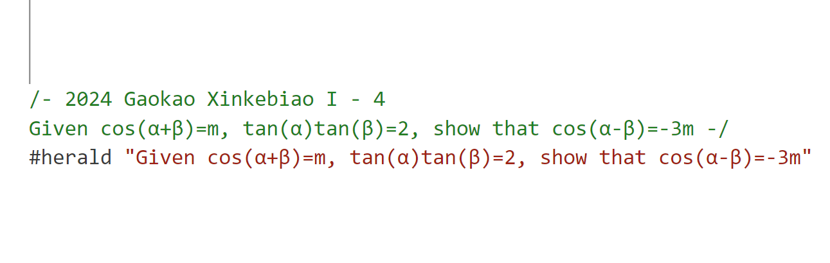
Lean translator

Slide 21
More links
References:
Mechanics of Proof: https://hrmacbeth.github.io/math2001/
Mathematics in Lean: https://leanprover-community.github.io/mathematics_in_lean/
Lean for Curious Mathematicians: https://github.com/lftcm2023/lftcm2023
Previous Episodes in NUS-Math-Formalization:
Calculus Game: https://github.com/NUS-Math-Formalization/CalculusSkeleton
Mathematics in Lean: https://github.com/NUS-Math-Formalization/coxeter
Tools Link:
Leansearch: https://arxiv.org/abs/2403.13310v1
Herald: https://arxiv.org/abs/2410.10878

